Slide 1


VIX Rakamin Academy
Project-Based Intern: Big Data Analytics Virtual Internship PT. Kimia Farma Tbk
Big Data Analytics:
Salicyl Sales Dashboard
Created By : Vicky Jodie

Slide 2



Cover
List of Content
Project-Based Intern: Big Data Analytics Virtual Internship PT. Kimia Farma Tbk
List of Content
1. Background
Determine the background data and analysis
performed.
Data Process, Visualization, Insight
A l step of data proces until turn out visualize and the
elaborate of insights.
Suggestion
Advice and recommendations for company.
2. Table Used
There are 3 table that we wi l use according
the task of this project.
Tools:

Slide 3


Cover
List of Content
01. Background
Project-Based Intern: Big Data Analytics Virtual Internship PT. Kimia Farma Tbk
01. Background
Kimia Farma is the first pharmaceutical industry company in Indonesia which was founded by the Dutch East Indies Government in 1817.
In this project, I was assigned as Big Data Analytics at PT. KImia Farma, Tbk to do some task such as making report and dashboard related to sales data of Brand Salycil. After brief overview the data, it seem that the data starting from January to June 2022.

Slide 4

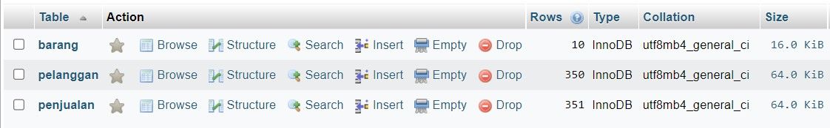
Cover
List of Content
1. BACKGROUND
02. Table Used
Project-Based Intern: Big Data Analytics Virtual Internship PT. Kimia Farma Tbk
02. Table Used
There are 3 table used such as : Table Penjualan (Sales), Table Pelanggan (Customer), Table Baang (Product). All of them have already available from Kimia Farma's data and I using MySQL to convert it.
Link to see Dataset: https://docs.google.com/spreadsheets/d/1KDwVAvHttgzrgMbUtD5fxYF4266JStkZ/edit?usp=share_link&ouid=104630564271867774996&rtpof=true&sd=true

Slide 5


Cover
List of Content
01.
Background
02. Table Used
03. Data Process, Visualization, Insights
Project-Based Intern: Big Data Analytics Virtual Internship PT. Kimia Farma Tbk
03. Data Process, Visualization, and Insights
List to do :
In this project, I using SQL Querying by MySQL for data warehousing and do analysis until consists 3 tables such as : table sales, table customer, table product.
Then, I did visualization analysis by creating Sales Dashboard using Google
Data Studio.
At the last, I elaborate my analysis and give some suggestions.

Slide 6

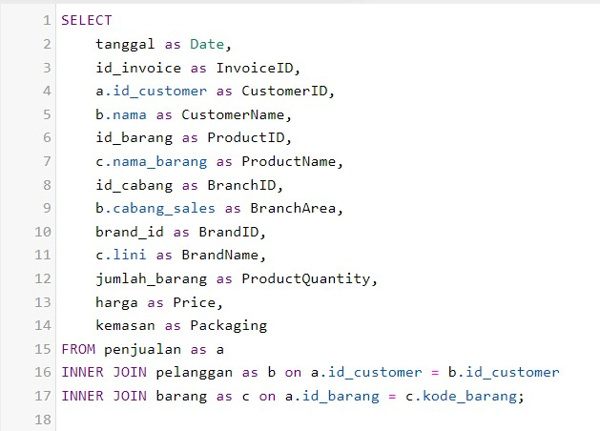
Cover
List of Content
01. 02. Table Used Background
03. Data Process, Visualization,
Insghts
Project-Based Intern: Big Data Analytics Virtual Internship PT. Kimia Farma Tbk
SQL Query for preparing the data before visualization
If you want to reach my visualization. Please check this link :
https://datastudio.google.com/u/0/reporting/e0e8d21a-2294-4be4-8e98-12333470988d/page/QpI8C

Slide 7
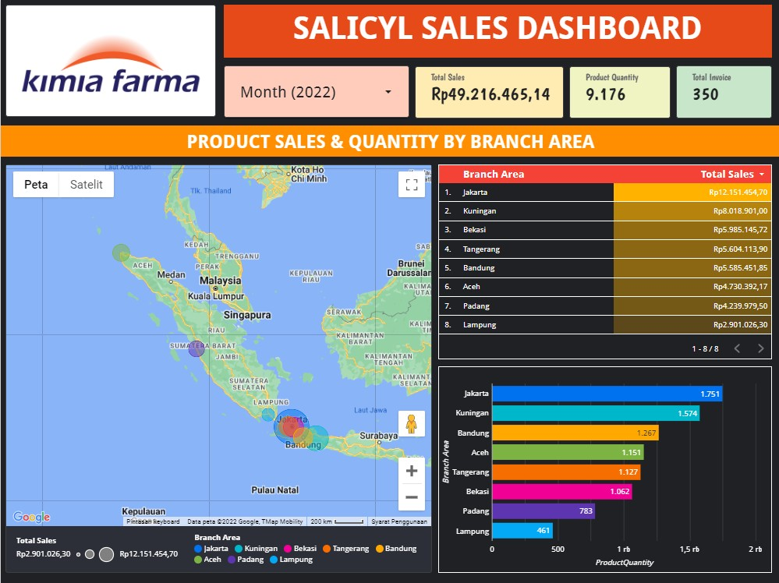
Cover
List of Content
01. 02. Table Used Background
03. Data Process, Visualization,
Insghts
Project-Based Intern: Big Data Analytics Virtual Internship PT. Kimia Farma Tbk
Overview Visualization
This is visualization for all total sales, total product quantity, total invoice, month (using filter) and also overview about product sales & quantity by branch area.
Insight :
As the result of beside visualization, the most sales are in Jakarta branch area with amount Rp 12.151.454,70 and also has the highest number of product quantity too with amount 1.751

Slide 8
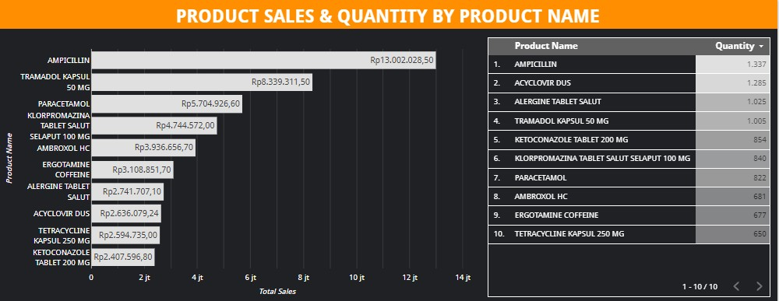
Cover
List of Content
01.
Background
02. Table Used
03. Data Process, Visualization, Insights
Project-Based Intern: Big Data Analytics Virtual Internship PT. Kimia Farma Tbk
Insight :
Based on the visualization shows that the sales of the top three products (highest sales) are Ampicillin (Rp 13.002.028,50), Tramadol Kapsul 50 mg (Rp 8.339.311,50), and Paracetamol (IRp 5.704.926,60). Meanwhile, when viewed from product quantity, there is a slight difference where the three products with the most supply are Ampicillin (1,377), Acyclovir Box(1,285), and Allergen Tablet Coated (1,025).
It indicates an imbalance between sales and the availability of drug stocks. Because there are some drugs whose sales are high, but the stock is low, and vice versa.

Slide 9
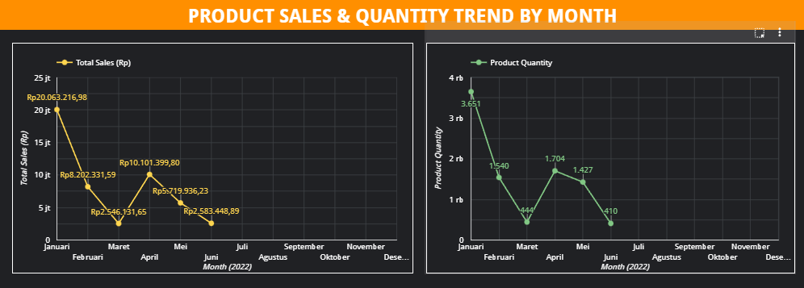
Cover
List of Content
01.
Background
02. Table Used
03. Data Process, Visualization, Insghts
Project-Based Intern: Big Data Analytics Virtual Internship PT. Kimia Farma Tbk
Insight :
From the graph, we can see that the number of product sales and product quantity trend almost the same (volatile trend). However, it seems to start to differ significantly in April - June 2022. This is indicate that supply product quantity in April - June 2022 more higher than the product sales of the months. As same like the first insights at previous slide that indicates an imbalance between sales and the availability of drug stocks.

Slide 10
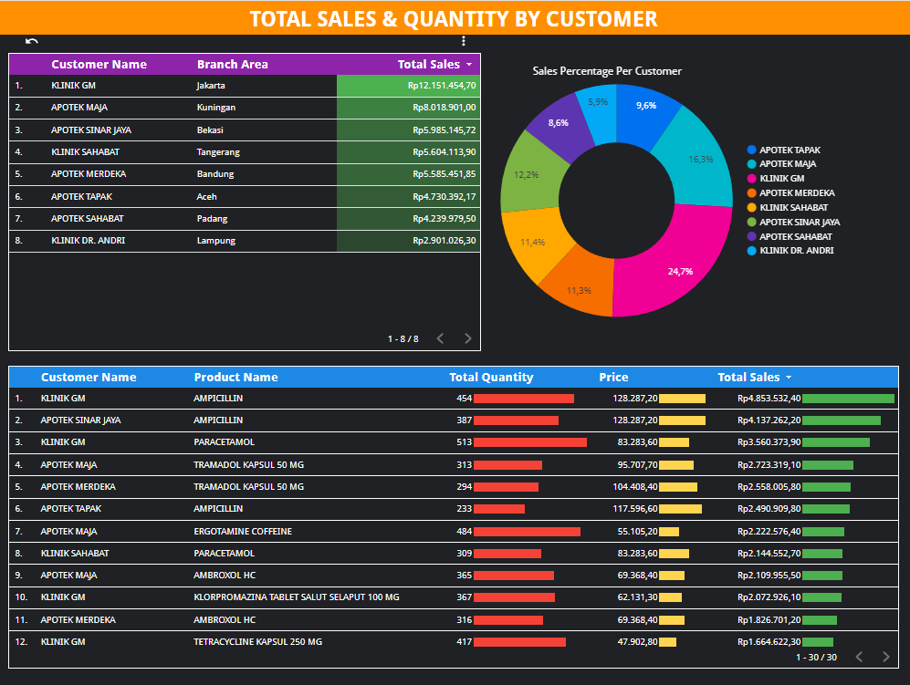
Cover
List of Content
01.
Background
02. Table Used
03. Data Process, Visualization, Insights
Project-Based Intern: Big Data Analytics Virtual Internship PT. Kimia Farma Tbk
Insight :
This visualization show about the details of total sales per customer and per branch area and also the table of detail purchase per customer that shows their total quantity, price, and total sales for all products are purchased.
For example, the GM Clinic is the best customer with the most purchases of “Ampicillin” products, so the company decides to make it the best customer because the company has the highest sales from that customer.

Slide 11


03. Data Proces , Visualization, Insghts
Cover
List of Content
01.
Background
02. Table Used
04. Suggestion
Project-Based Intern: Big Data Analytics Virtual Internship PT. Kimia Farma Tbk
04. Solutions
The dataset especially for customer data will be perfect if it contains of address, email, and phone number in order to make sure that company can do some investigation if has problems in the future or may give their some promotions.
Meanwhile, for product quantity (stocks) can be adjusted according the weather conditions or the report of health data in certain areas. We must focused in the area which diseases often occur and ensure the product needs are available and also ensure that no products accumulate and expired.

Slide 12




Cover
List of Content
01.
Background
02. Table of Interest
03. Data Proce
04. Suggestion
Thank You
Project-Based Intern: Big Data Analytics Virtual Internship PT. Kimia Farma Tbk
Thank You!
Reach me on : :
+6281291576499
vickyjwang9696@gmail.com
linkedin.com/in/vicky-jodie/

